Slide 1
Is Staten Island more like other Boroughs of New York City?
Sulochana Vitharana

Slide 2
Question
In this project, I'm compare the Staten Island Neighborhoods and four other boroughs in New York. such as Manhattan, Bronx, Queens and Brooklyn. To find out the similarity and differences in Staten Island and other five Boroughs. This project will help the people who wants to move to Staten Island and tourist who plan to visit Staten Island. Also, It helps to people who are looking for a buy a house in Staten Island.

Slide 3
Data Description
I used Foursquare API to get the most common venues of five Boroughs of New York City.
I used this dataset. https://geo.nyu.edu/catalog/nyu_2451_34572
Segment and cluster each boroughs neighborhoods separately.
Finally compare the Staten Island neighborhoods to other neighborhoods to conclude the results.

Slide 4
Methodology
Download and Explore Dataset
Create a map of New York with neighborhoods superimposed on top
Analyze each Neighborhood
Cluster Neighborhoods

Slide 5
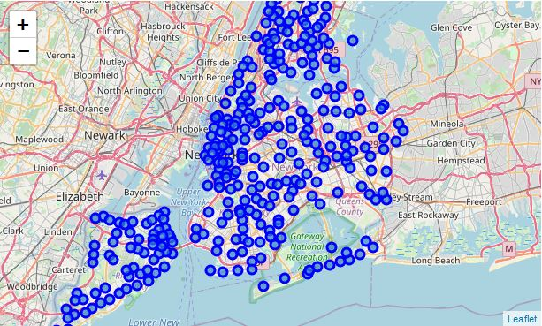
New York City Neighborhoods

Slide 6
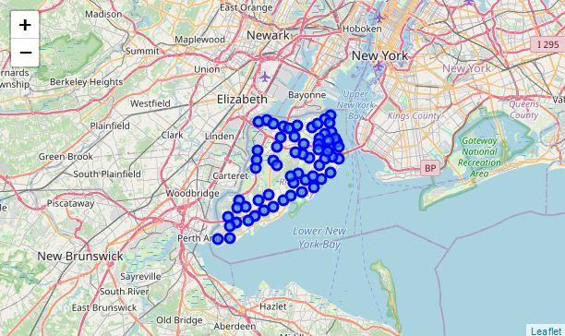
Staten Island Neighborhoods

Slide 7
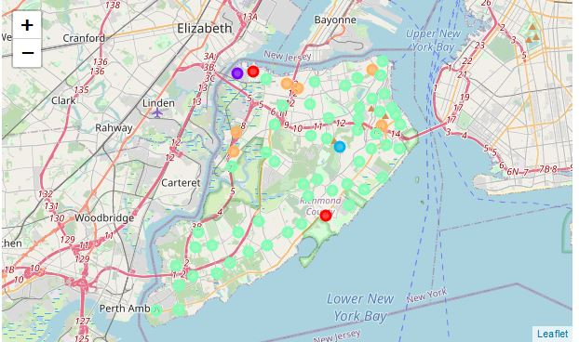
Cluster Neighborhoods

Slide 8
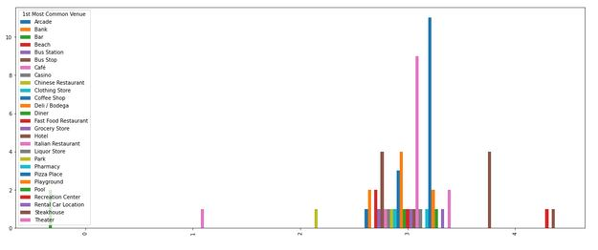
Estimate the number of 1St most common venue in each cluster.

Slide 9
Conclusion
As a result, people are turning to big cities to start a business or work. For this reason, people can achieve better outcomes through their access to the platforms where such information is provided. Not only for investors but also city managers can manage the city more regularly by using similar data analysis types or platforms.

